Slide 1

HERON: Full IES Simulation
FORCE Overview and Training
April 4-6, 2023
Dylan McDowell
Modeling & Simulation Engineer
Idaho National Laboratory

Slide 2
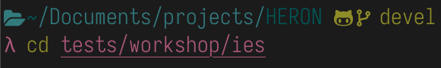
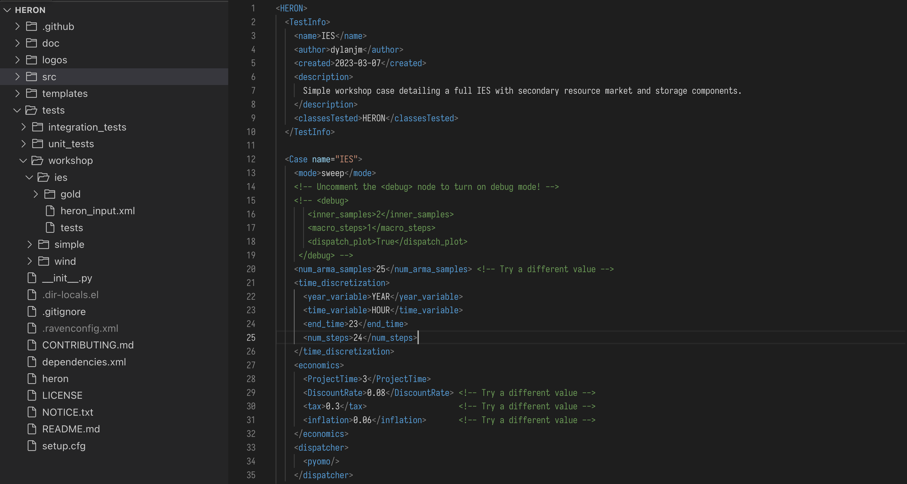
Getting Started
Navigate into the IES workshop folder
Open heron_input.xml
VSCode
Notepad
Emacs

Slide 3

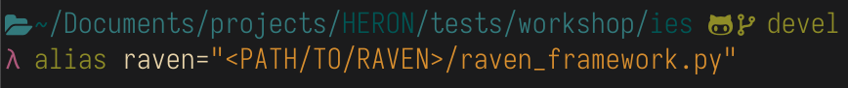

Shortcut Reminder
Run the following commands to make running HERON & RAVEN easier:
Now your commands will look like this:

Slide 4
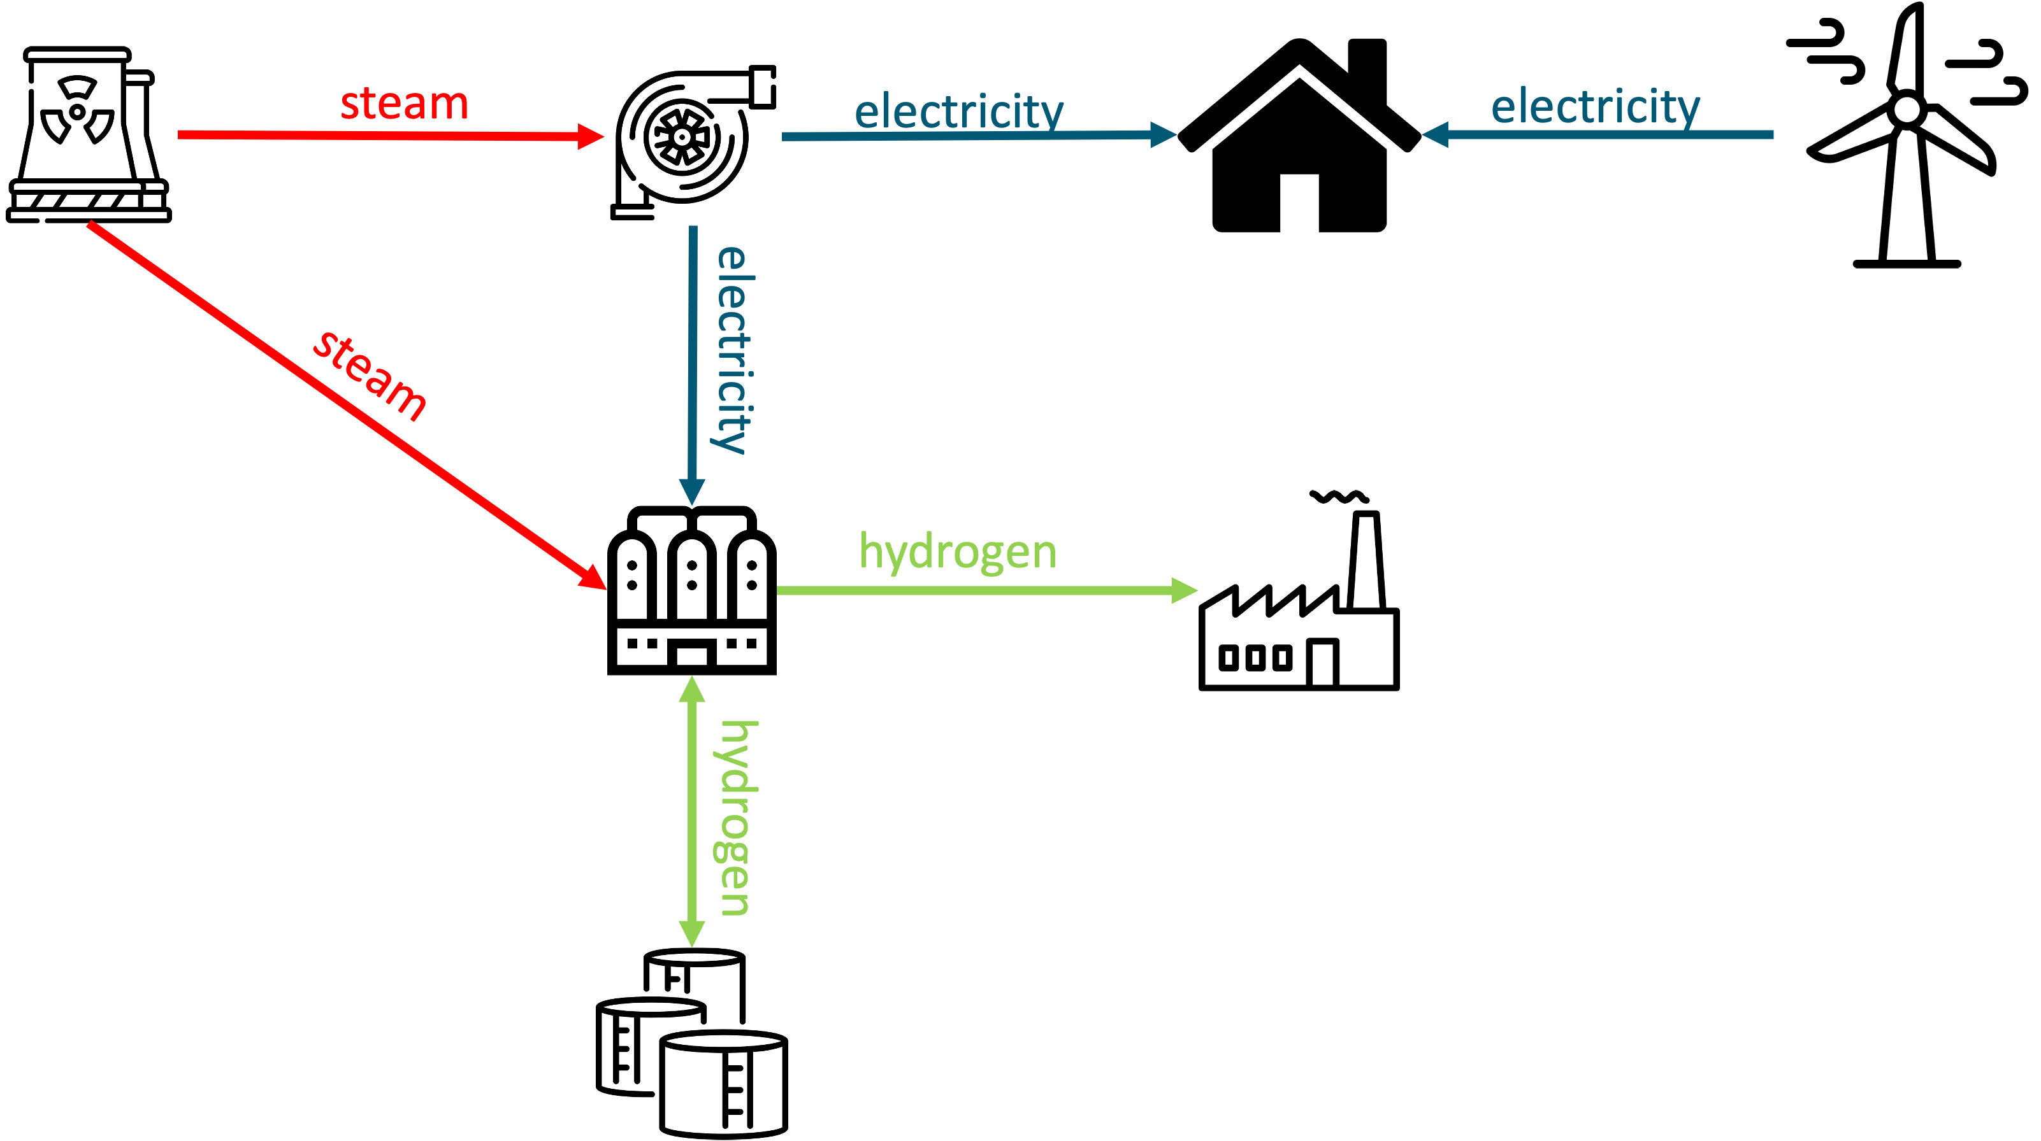
System Configuration & Case Information
Project Lifetime | 3 Years
Discount Rate | 8%
Tax Rate | 30%
Inflation Rate | 6%
ARMA Samples | 25
Component | Capital Expenditure | Fixed O&M
Nuclear Power Plant (NPP) | $12.8M / MW
Wind Turbine | $1.3M / MW | $15,000 / MW
Steam Turbine | - | -
High Temperature Steam Electrolysis (HTSE) | $1.9M | $131,333
Hydrogen Storage | $1.2M | -
Component | Sales Price
Energy Grid Market | $100 / MW
Hydrogen Market | $8 / Kg
images: Flaticon.com

Slide 5
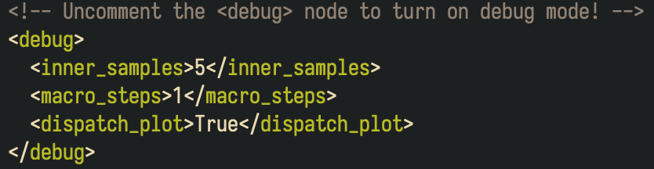
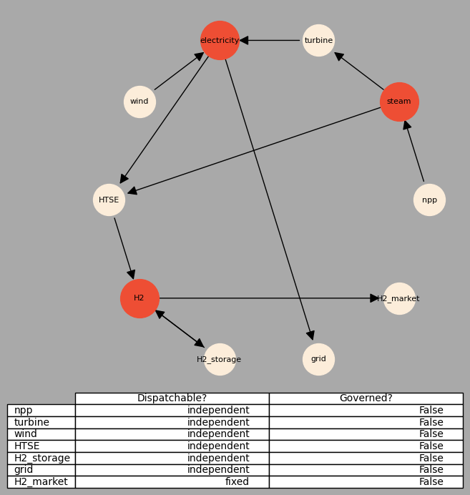
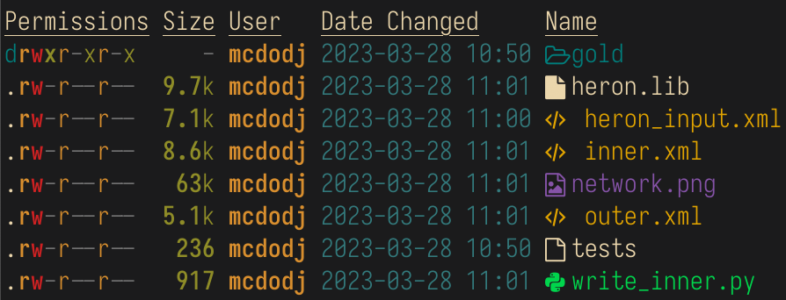
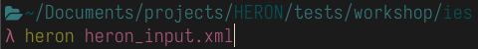
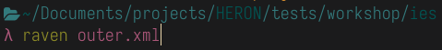
Debug Mode

Slide 6

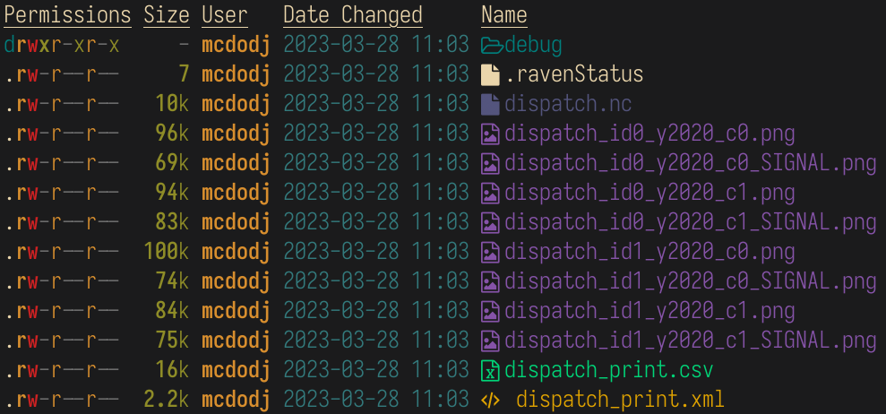
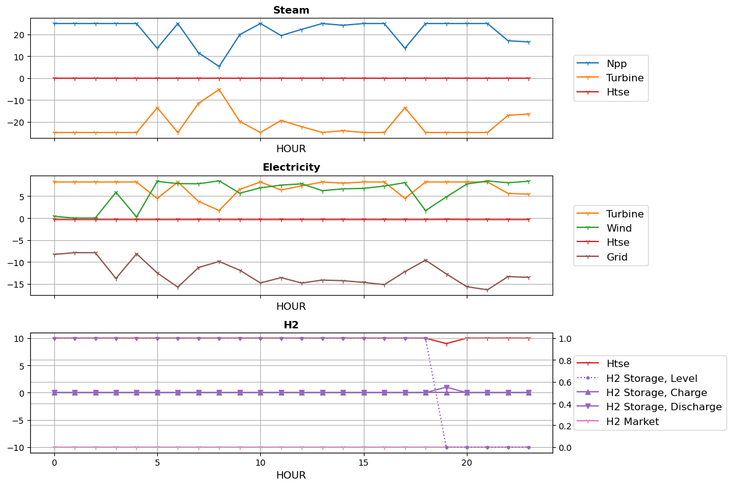
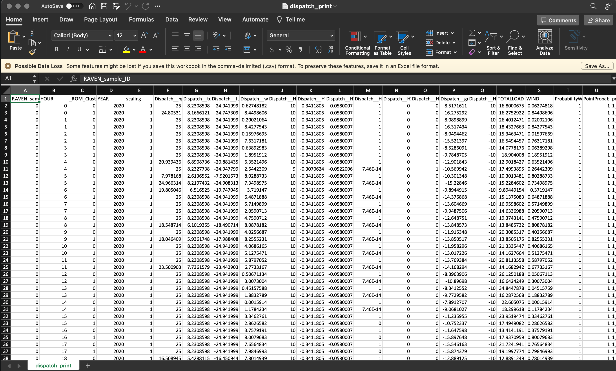
Debug Mode Continued…

Slide 7

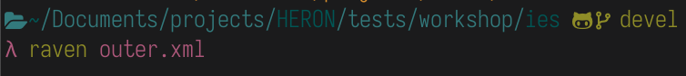
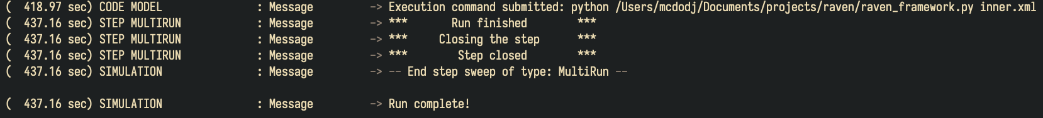
Sweep Run
Now let’s go ahead and run an entire sweep case:

Slide 8
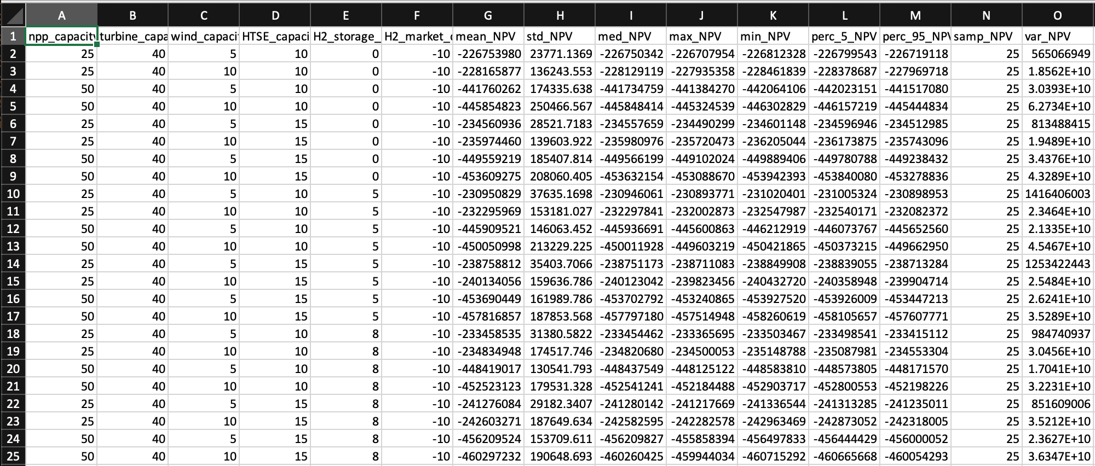
Sweep Run Continued…
There should now be a sweep.csv inside of IES_o/
What system configuration provides the highest mean NPV?

Slide 9

Now it’s time to play!
What would it take to make the system profitable in only three years?
What about a 20-year investment timeline?
Try replacing the 3 year synthetic history with a 20-year one:
The file-path:
Remember to change ProjectTime
Try adding a Lithium-Ion Battery for electricity storage
How does std_NPV change as you increase the number of samples?
What would it take to run an optimizing case?
What happens if you fix the dispatch of the H2 Market and the grid?

Slide 10



Hints… 20 Year Investment Horizon
You may also want to change the lifetime nodes to last longer than 5 years:

Slide 11
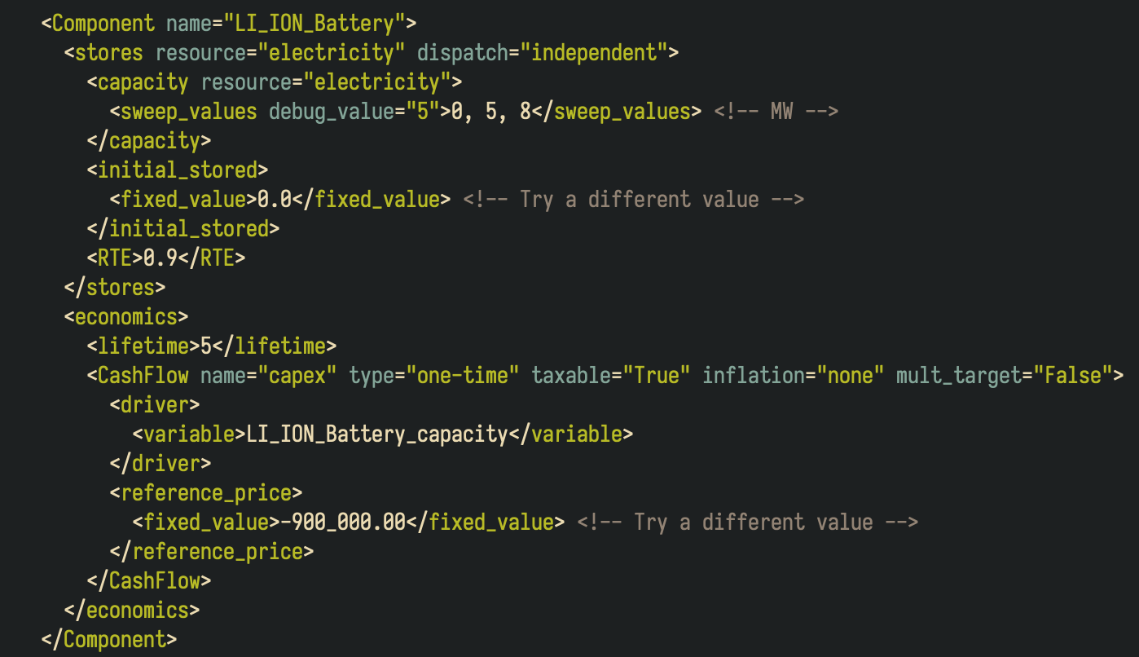
Hints… Adding Lithium-Ion Battery
Start by copying the H2 Storage Node and then modifying as necessary

Slide 12



Hints… Optimization Runs
Change all sweep_values to opt_bounds
Note: This may take a long time to run!
To see pre-run optimization results, look in: gold/IES_o/opt_soln_0.csv

Slide 13
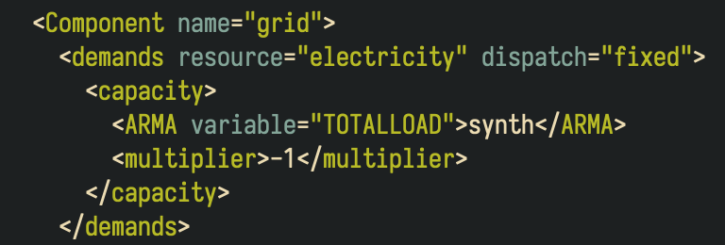
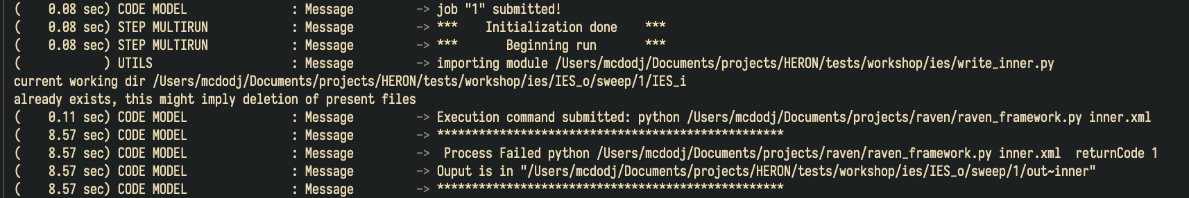
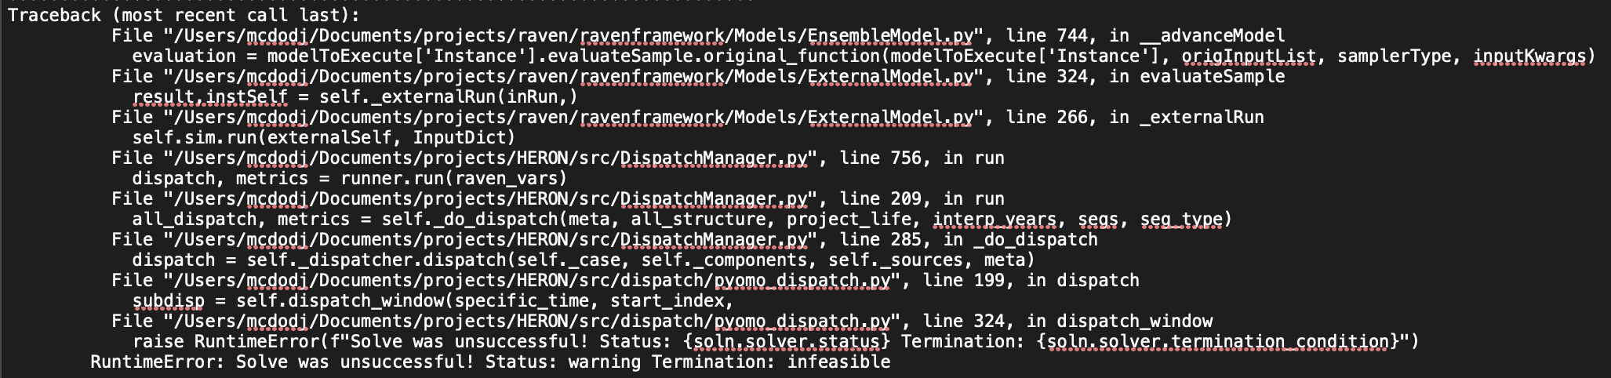
Hints… Fixing Grid Dispatch
Open:
IES_o/sweep/1/out~inner

Slide 14
What We Didn’t Cover
Custom Dispatching Strategies
Price-Taker vs. Price-Maker
Custom User-Defined Functions
Control Strategy for Storage
Different HERON Workflows:
DISPATCHES
MOPED
We are Open-Source!
Open an issue on repository
Contribute meaningful code changes

